Slide 1


CAPSTONE PROJECT PHASE A
THE TOOL FOR COMPUTATIONAL SIMULATION THE EARTH ENERGY ABSORPTION AND CLIMATE CHANGE
Supervisor :
Dr. Zakharia Frenkel
Haya Kabishi 211582978
Daniella Kadmany 314701699

Slide 2






Motivation
Humidity
Sun
Public health
Ocean
Agriculture
Wind

Slide 3
INTRODUCTION
How the absorbed solar Energy affect Climate Change?
Our goal is to create a simulation tool that examines energy absorption in natural systems, particularly focusing on oceans, which are the primary drivers of climatic thermodynamics.
This tool will assess how absorbed energy affects weather patterns and climate change.

Slide 4
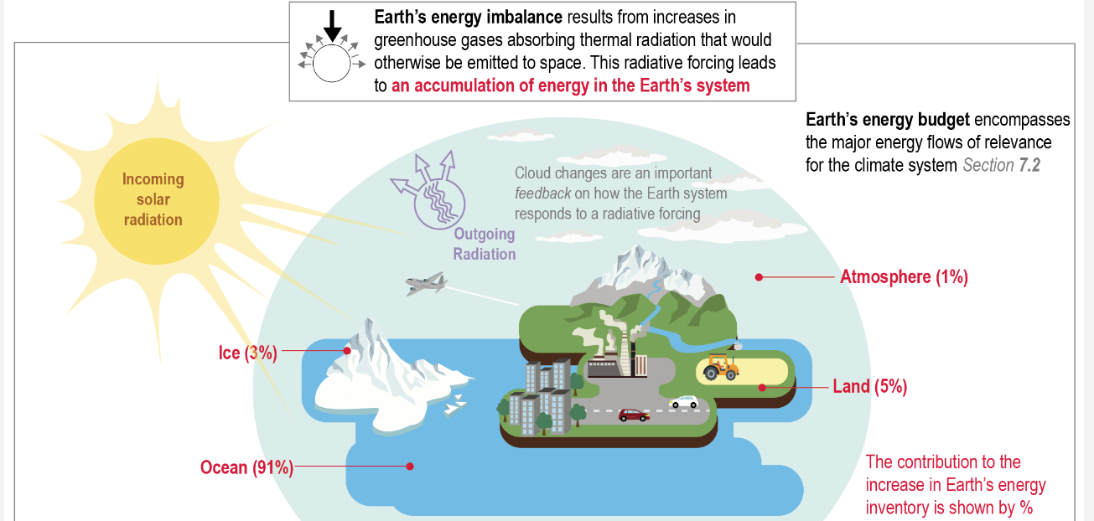
EARTHS ENERGY BUDGET
The Earth's energy budget describes the balance between incoming solar radiation and outgoing radiation.
•One third of sunlight is reflected back into space while the remaining two thirds are absorbed.
•Oceans absorb 91% of excess heat , playing a critical role in temperature regulation .

Slide 5
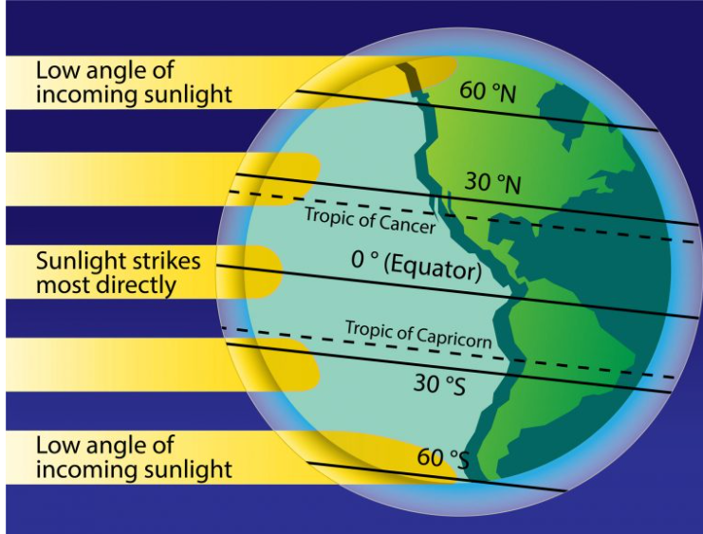
SOLAR RADIATION AND ANGELS
•Solar Radiation: refers to the Energy from the sun that reaches the Earth’s surface both directly and diffusely
•Solar Zenith Angle: The angle between the Sun’s rays and the vertical direction.
•Angle of Incidence:
1.Near the Equator
2. Near the Poles

Slide 6
ATMOSPHERE AND SURFACE
Absorption and Emission: The atmosphere and surface absorb, deflect, and emit radiation.
Reflection: Clouds and particles reflect solar radiation, with high albedo surfaces reflecting more sunlight.
Greenhouse Gas Effect: GHGs trap and re-radiate longwave radiation.

Slide 7

WORLD OCEAN
•Absorbs most solar radiation, affecting sea surface temperatures.
•Major carbon sink, taking in 25% of human-produced CO2.
•Ocean currents like the Gulf Stream redistribute heat globally.
•Feedback loops from ocean warming intensify extreme weather events.

Slide 8
DATASET
We have chosen crucial variables using two key dataset:
•ERA5 for historical data
•CoolProp for thermodynamic data

Slide 9

Our Solution – Earth Energy Absorption Simulation Tool
We are going to create a new energy absorption simulation tool integrating environmental data and to apply this tool for climate change forecast.
The work will include :
Earth Division for Analysis
Data Integration and Modeling
Simulation and Visualization

Slide 10

Our Solution – Earth Energy Absorption Simulation Tool
01
Divide the Earth into uniformly sized squares

Slide 11
Our Solution – Earth Energy Absorption Simulation Tool
02
Collect Climate Data
Utilizing CoolProps thermodynamic data for 100+ fluids Data
Utilizing ERA5's climate reanalysis data.

Slide 12
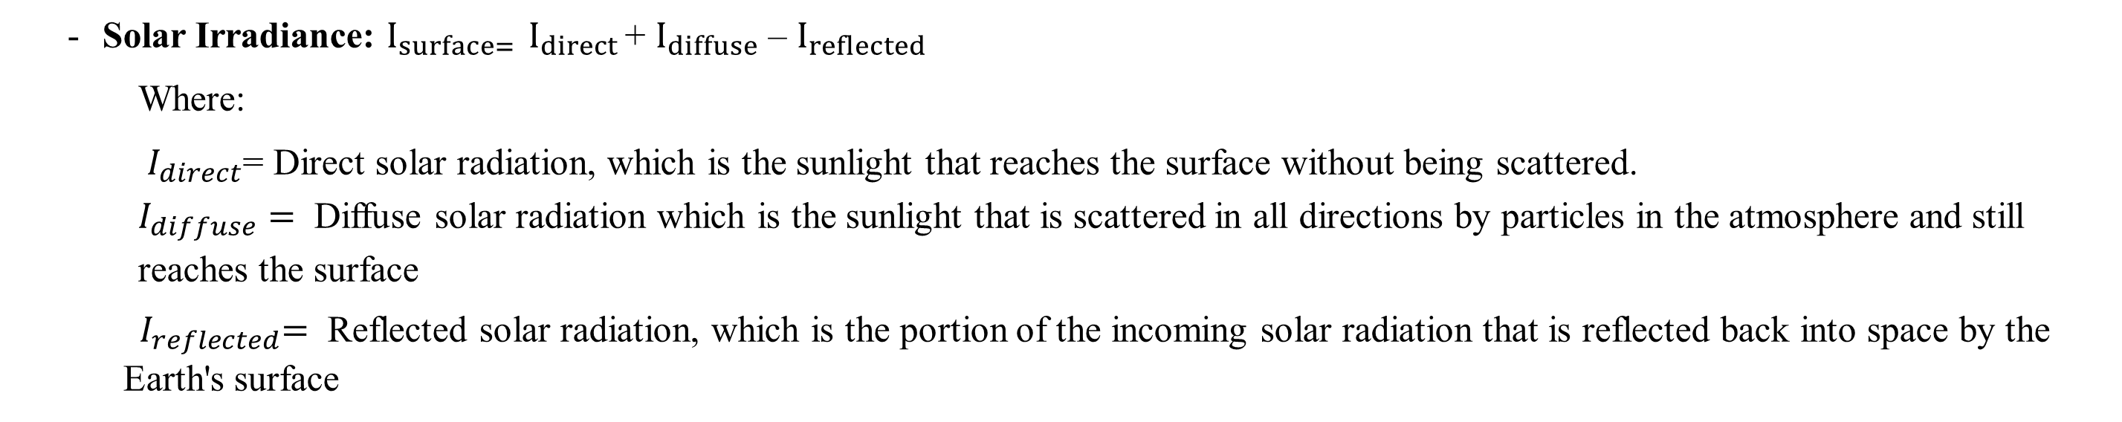
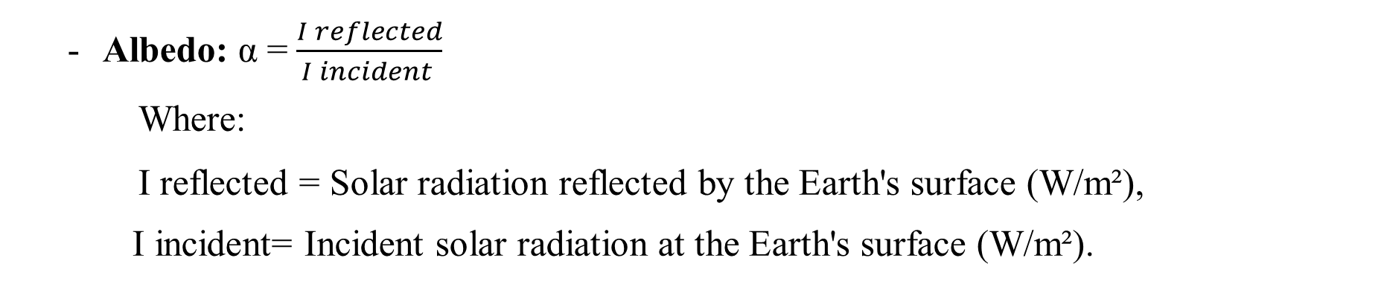
Our Solution – Earth Energy Absorption Simulation Tool
03
Calculate Energy Absorption
Solar Irradiance: $I_{surface= }I_{direct }$+ $I_{diffuse}$ – $I_{reflected }$
Where:
$I_{direct}$= Direct solar radiation, which is the sunlight that reaches the surface without being scattered. $I_{diffuse}=$ Diffuse solar radiation which is the sunlight that is scattered in all directions by particles in the atmosphere and still reaches the surface
${ I}_{reflected}=$ Reflected solar radiation, which is the portion of the incoming solar radiation that is reflected back into space by the Earth's surface
Albedo: α = $\frac{I reflected}{I incident }$
Where:
I reflected​ = Solar radiation reflected by the Earth's surface (W/m²),
I incident= Incident solar radiation at the Earth's surface (W/m²).

Slide 13
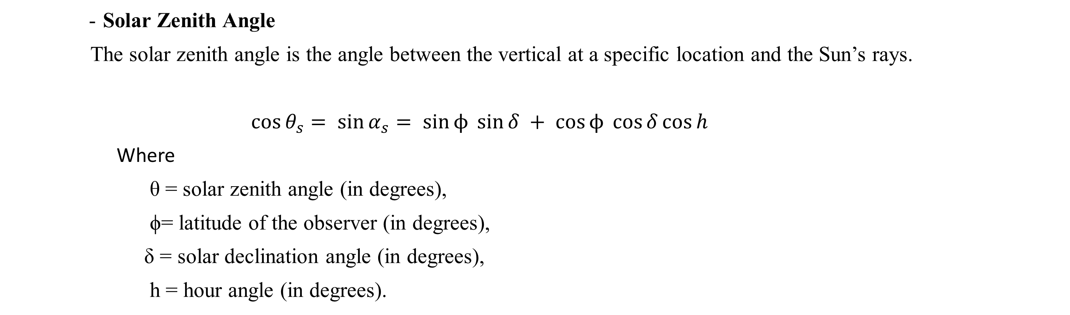
Solar Zenith Angle
The solar zenith angle is the angle between the vertical at a specific location and the Sun’s rays.
$$\cos{θ_{s}}= \sin{α_{s}}= \sin{ϕ }\sin{δ} + \cos{ϕ }\cos{δ}\cos{h}$$
Where
θ = solar zenith angle (in degrees),
ϕ= latitude of the observer (in degrees),
δ = solar declination angle (in degrees),
h = hour angle (in degrees).
Heat Capacity
The relationship between the change in thermal energy and the temperature change.
delta(E) = C*delta(T)
Where
Delta (E)- represents the change in thermal energy (Joules, J)
C - is the heat capacity (Joules per degree Celsius, J/°C)
Delta (T) - is the change in temperature (°C)

Slide 14
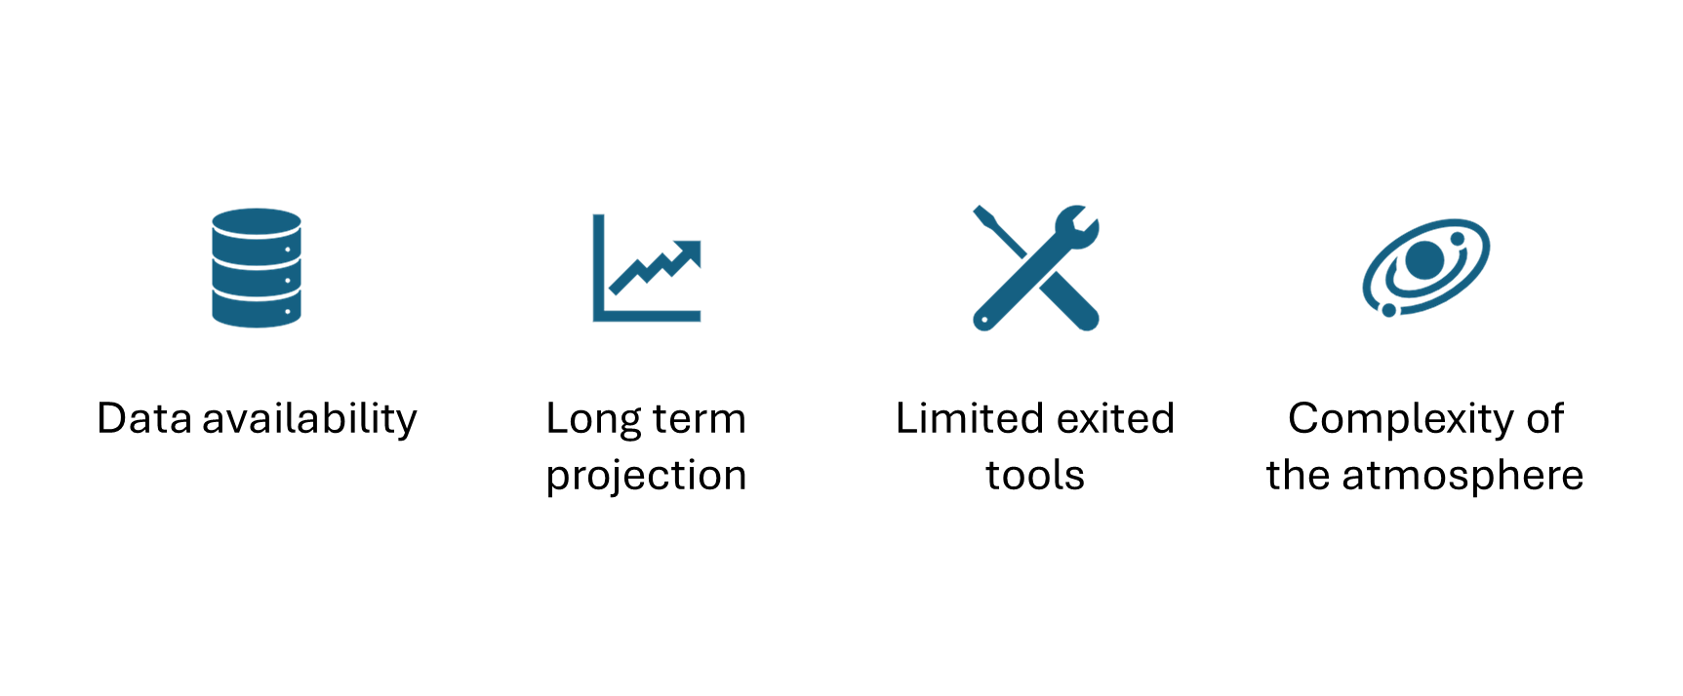
CHALLENGES

Slide 15
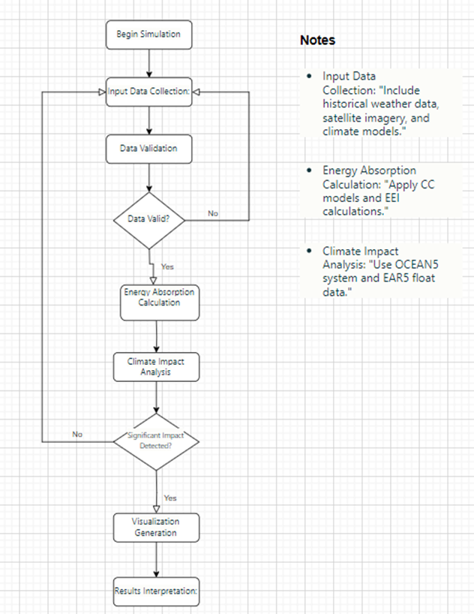
Simulation Process Flow

Slide 16
Simulation Process Flow
Commence Simulation (Start): Initiates the procedure.
Data Collection: Acquires historical meteorological data, satellite photos, and climatic computer models.
Data Validation: Verifies the accuracy and completeness of data.
Energy Absorption Calculation: Uses thermodynamic models and EEI computational methods to calculate energy absorption.
Analysis of Climate Impact: Examines the influence on climate patterns using data from the CoolProp and EAR5 float.
Visualization Generation: Generates graphical representations of the obtained results.
Results Interpretation: Analyzes results to determine their climate implications.
Generate Report (End): Finalizes the operational procedure.

Slide 17
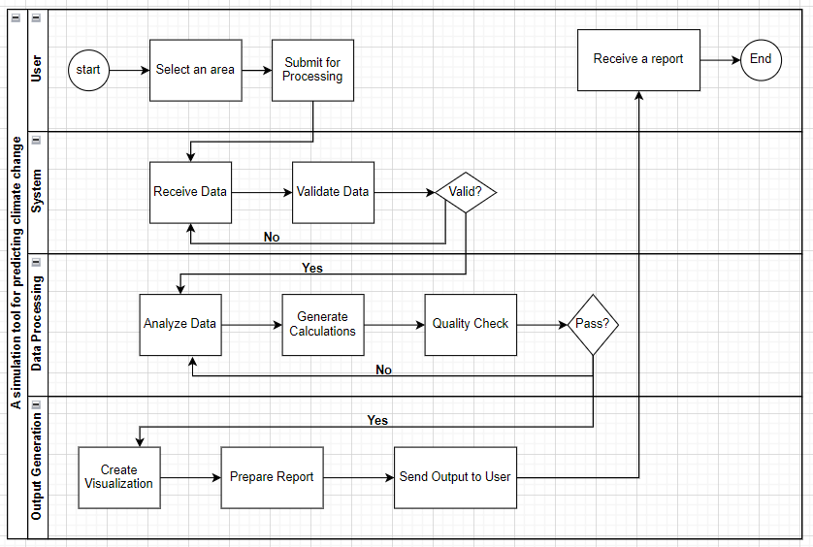
Activity
Diagram

Slide 18
Activity Diagram
The user initiates the process by selecting an area and submitting inputs.
The system receives, validates, processes, and saves the data.
Data processing involves analysis, calculations, and quality checks.
Output generation creates visualizations, prepares a report, and sends it to the user.

Slide 19
TEST PLAN
Algorithm Logic Test: Energy Absorption Correlation
Technical Test: Data Validation
The system makes sure it is correct by checking that the input data and function outputs are complete, formatted correctly, and exact while they are being processed.
The tool tests the precision and uniformity of its results by comparing them with recognized scientific conclusions about climate change.

Slide 20


CONCLUSION
Creating Tools: The project produces a computational tool to analyze energy absorption in natural systems, especially Earth's oceans
Climate Insights: The tool uses historical data and advanced modeling to reveal how energy absorption shapes climate and weather patterns.

Slide 21

THANK YOU

